Slide 1
ECE 4605 Project 3
Andre Jaberi, Tyler French, Stephen Via, Peter Nguyen

Slide 2
Data Cleaning
Normalize population-based features by county total population
Ex. (# of males) → (Male proportion of population)
Segment data by state
Removed outlier (New York City) to find more helpful trends

Slide 3
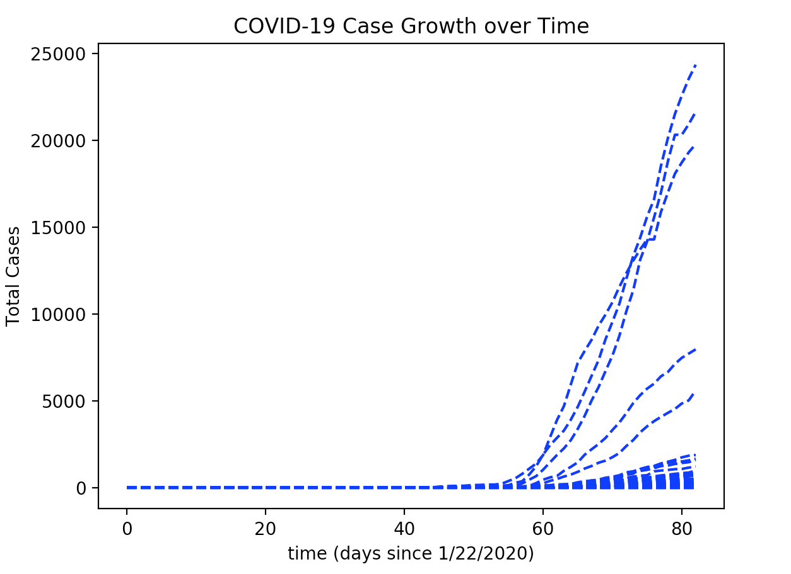

Preprocessing
Calculate 3 features from Timeseries:
Total Cases / Population
Total Deaths / Population
Average Rate of Spread
$r_{i}^{(l)}=\frac{\sum_{i∈days}{cases_{i}^{(l)} −cases_{i−1}^{(l)}}}{N}$
i = current day
L = current location

Slide 4
Model Selection Goal: Train model and show association of all variables vs. output parameters
Goal: Learn a mapping between Feature and Performance
Performance: Quantitative COVID-19 Data by county
Features: Array of demographic information by county
Regression Models: Supervised learning for quantitative continuous labels
Linear Regression
Random Forest Regression (Compound Quantitative Decision Trees)

Slide 5
Random Forest Regression
Train multiple decision trees for the prediction of discrete output values.
Average results from all predictions to create an interpolated quantitative output.

Slide 6
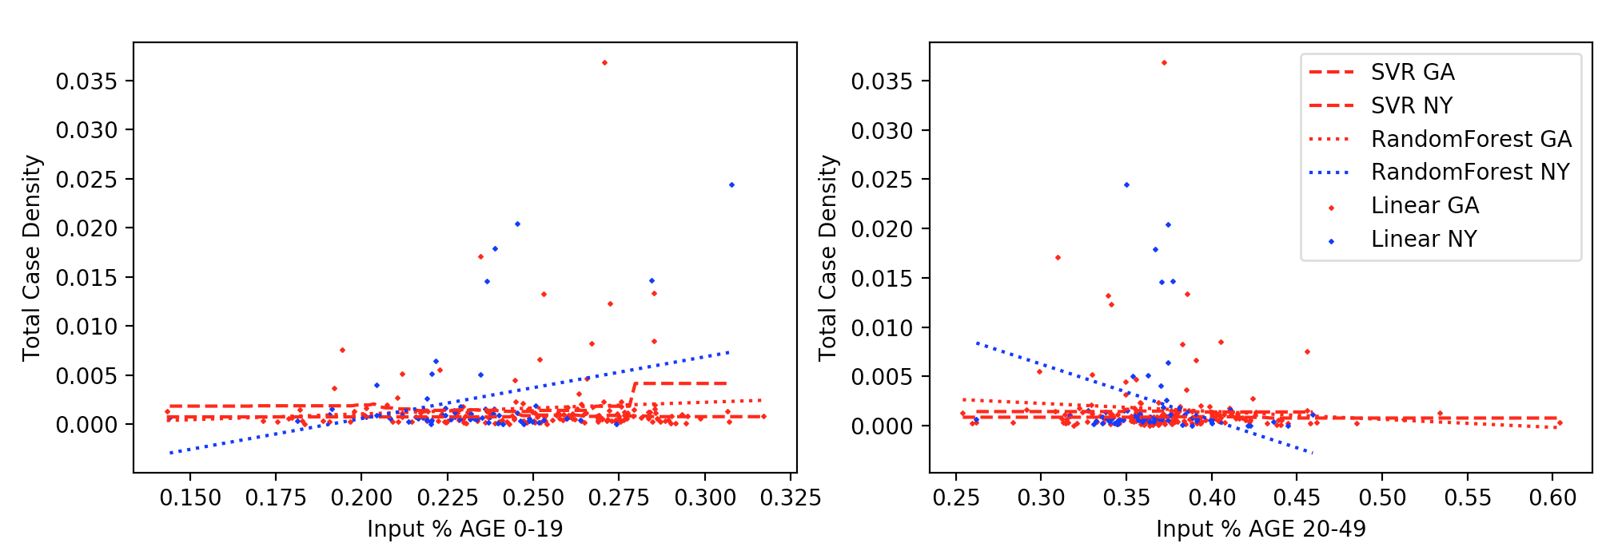
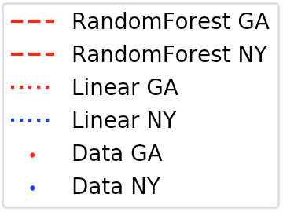
Learned Mapping Results (Age Comparison)
Counties with much younger populations show higher prevalence of COVID-19 Cases on average.

Slide 7
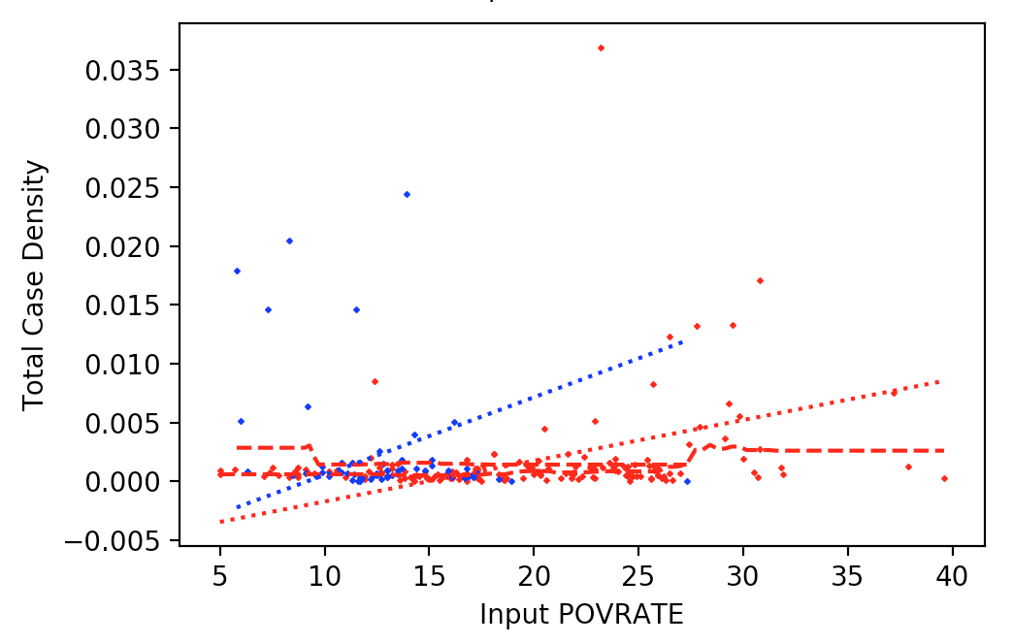
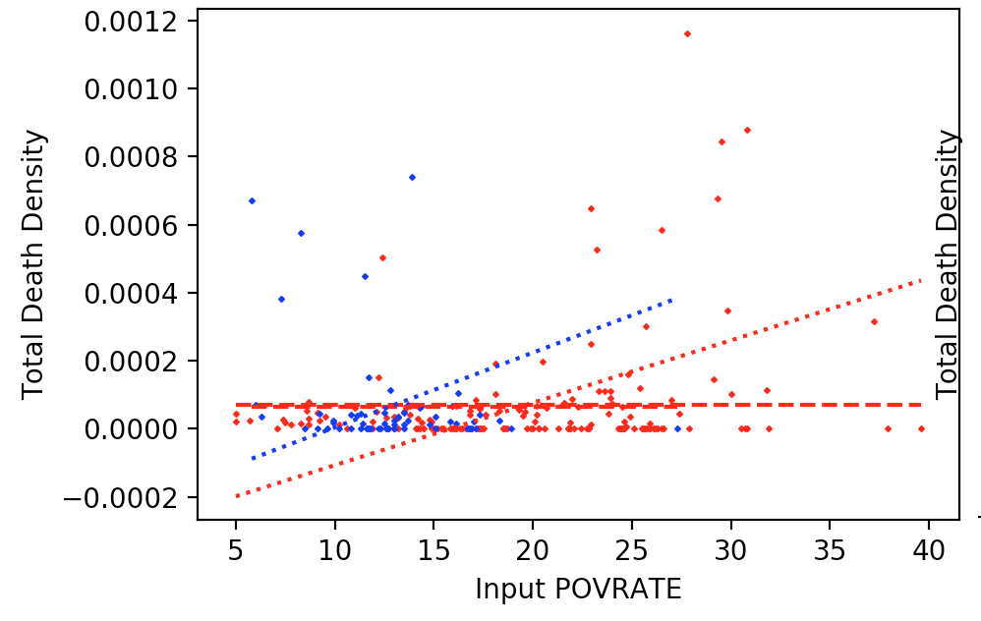
Learned Mapping Results (Poverty Rates)
Counties with much higher poverty proportions show higher prevalence of COVID-19 Cases on average.

